Slide 1
Crowd effects: returns, users preferences, and competition in crowdfunding
Sergei Izmalkov, Dilyara Khakimova and Pavel Smirnov
CEMI, Feb 2019

Slide 2
Overview
Crowdfunding – rapidly growing economic and social phenomenon
Financing of various projects by (a) crowd
Many papers exist: mostly focused on “static” effects (individual projects, characteristics of success)
We want to measure the crowd effects (for reward-based crowdfunding)
Based on data from Indiegogo, measure/ estimate/ build classification models for:
Users (backers) returns
Geographic and thematic preferences
Competitive pressure (size of the crowd)

Slide 3
Reward-Based Crowdfunding
Three types of agents:
Creator/ founder (entrepreneur)
Donors/ backers/ supporters
Platform/ intermediary
The platform: does the economic design/ matching/ transactions
The creator starts the project, announces details/ advertises
Funding goal (amount to be raised)
Time of the campaign
What the money is to be used for
Rewards for backers/ Other conditions
Notes:
Source: https://www.statista.com/outlook/335/100/crowdfunding/worldwide

Slide 4
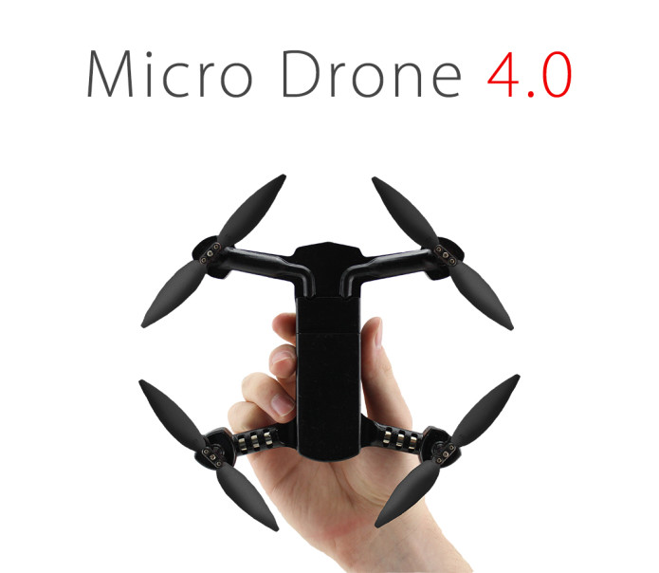
Reward-Based Crowdfunding Example
Notes:
Source: https://www.statista.com/outlook/335/100/crowdfunding/worldwide

Slide 5
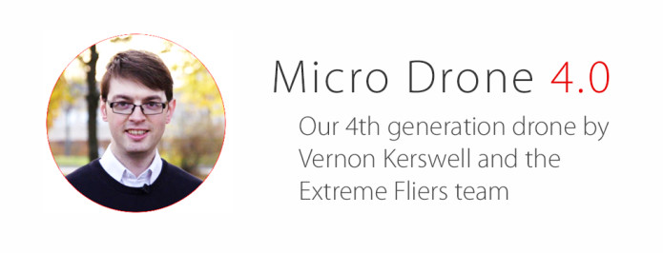
Reward-Based Crowdfunding Example
Micro Drone 4.0: Small, Intelligent, Autonomous
A palm-sized autonomous drone under $200 that captures smooth aerial video
$292,229 USD raised by 1930 backers
389% of $75,000 flexible goal
24 days left
Notes:
Source: https://www.statista.com/outlook/335/100/crowdfunding/worldwide

Slide 6
Reward-Based Crowdfunding in numbers (the world)
Transaction Value in the Crowdfunding segment amounts to US$6,839m in 2019. (growth 30%)
Transaction Value is expected to show an annual growth rate (CAGR 2019-2022) of 17.1% resulting in the total amount of US$10,990.7m by 2022.
The average funding per campaign in the Crowdfunding segment amounts to US$787 in 2019.
Top country: China (US$5,572m in 2019).
Russia $26.7 mln
Notes:
Source: https://www.statista.com/outlook/335/100/crowdfunding/worldwide

Slide 7
Crowdfunding: parallels
Procurement auctions
- 15-20% of GDP in OECD countries
variety of products/ services/ conditions/ concerns
cost-plus contracts/ scoring auctions/ collusion
dynamic/ conditional contracts
Online ads
rapid growth (15-40% a year)
role of platform/ intermediary
Both: design is valuable
key issues: objectives/ primitives/ constraints

Slide 8
Alphabet (Google)
6+ BLN searches/ auctions per day (!)

Slide 9
Overview of projects and dollars on crowdfunding platform Kickstarter as of January 2019
Projects and dollars | Projects, million U.S. dollars, success rate in percent
Launched projects | 429,347
Total dollars pledged (billion U.S. dollars) | 4.07
Successful dollars (billion U.S. dollars) | 3.63
Unsuccessful dollars (million U.S. dollars) | 420
Live dollars (million U.S. dollars) | 19
Live projects | 2,443
Success rate (%) | 36.63

Slide 10
Crowdfunding: types
Reward-based
Star Citizen (game, Kickstarter, ongoing, $200mln+)
Equity-based
ICO (initial coin offerings)
EOS blockchain etherium ($4bln+), 2018
Debt-based
Donation-based

Slide 11
Crowdfunding overall (US, old*)

Slide 12
Crowdfunding overall (US)
$90 billion at 2018 (projection)
Key development: all (kinds) of investors can participate (2018), projected explosive growth
Venture capital and angel investment investment $50 billion a year (2015): CF should have passed in 2016
Many regulation/ legal/ platform design issues

Slide 13
Crowdinvesting (world)
Transaction Value in the Crowdinvesting segment amounts to US$4,686m in 2019. (growth 25%)
Transaction Value is expected to show an annual growth rate (CAGR 2019-2022) of 15.7% resulting in the total amount of US$7,252.3m by 2022.
The average funding per campaign in the Crowdinvesting segment amounts to US$104,780 in 2019.
Top country is China (US$833m in 2019), US, Israel, UK is close behind
Russia $53mln
Notes:
https://www.statista.com/outlook/377/100/crowdinvesting/worldwide

Slide 14
Crowdfunding: questions
Economics: What is it? Why it is not a fluke? Why do people contribute?
new products
donation vs monetary incentives
superior/ alternative way to evaluate (future) demand
(distributed) screening/ moral hazard
Finance: Alternative financing, why not banking/ venture capital?
(online) highly improved access to funds
ability to raise/ aggregate small amounts
proof of concept for future financing
Sociology: Crowdsourcing? Why does the crowd participate?
Hearding
Community engagement/ social networks
CS/ Operations Research/ Market Design
How to run platforms? (match/ advertise/ select parameters)
How to screen/ enforce/ encourage pro-social behavior
Notes:
https://www.statista.com/outlook/377/100/crowdinvesting/worldwide

Slide 15
Crowdfunding: difficulties
Rapidly growing (and changing) industry
Substantial heterogeneity in projects
Limited data on important components/ endogeneity
social connections of supporters (shown to be important)
do you contribute because your friends have contributed or on your own
information available/ advertisements/ alerts
history of pledges/ anonymity of some users
post-campaign history
Many papers: measure whatever they can based on the data; most common question: predict the probability of success
Due to (important) differences in data sources, findings difficult to compare/ replicate/ could be contradictory
We look at the crowd: can we identify (any) links among the pledgers? (without social networks)
Notes:
https://www.statista.com/outlook/377/100/crowdinvesting/worldwide

Slide 16
Crowdfunding (history)
Unclear..
As definitions are unclear..
In the past: subscriptions (books), war bonds, …
1997: online campaign to raise funds for US Tour of the British group Marillion (raised $60+ thsd)
2003, specialized platform ArtistShare
2008, general platforms, Indiegogo, Kickstarter (2009)
growth: 53 platforms with $1Bln in 2009 to 750 platforms with $12Bln in 2014

Slide 17
Some notable results
The Geography of Crowdfunding
Ajay K. Agrawal, Christian Catalini, Avi Goldfarb
NBER Working Paper No. 16820 (2011)
NBER Program(s):Productivity, Innovation, and Entrepreneurship
Artist-entrepreneurs connected with investors for musical projects
Broad geographical dispersion: the average distance is about 3,000 miles
Local investors invest earlier, less responsive to other investments
Evidence for “family and friends” investment
The platform seems to eliminate economic frictions, monitors progress, provides info

Slide 18
Some notable results
Ajay Agrawal, Christian Catalini, and Avi Goldfarb, "Some Simple Economics of Crowdfunding," Innovation Policy and the Economy 14 (2014): 63-97.
“We highlight the extent to which economic theory, in particular transaction costs, reputation, and market design, can explain the rise of nonequity crowdfunding and offer a framework for speculating on how equity-based crowdfunding may unfold. We conclude by articulating open questions related to how crowdfunding may affect social welfare and the rate and direction of innovation”

Slide 19
Some notable results
The dynamics of crowdfunding: An exploratory study
By Ethan Mollick
Journal of Business Venturing Volume 29, Issue 1, 2014
Studies 48,500 projects with combined funding over $237 M,
Interested in success and failure among crowdfunded ventures
Personal networks, underlying project quality, geography matter
Vast majority of founders seem to fulfill their obligations to funders
But, over 75% deliver products later than expected

Slide 20
Some notable results
A Theory of Crowdfunding: A Mechanism Design Approach with Demand Uncertainty and Moral Hazard
Roland Strausz
AMERICAN ECONOMIC REVIEW VOL. 107, NO. 6, JUNE 2017
“Crowdfunding provides innovation in enabling entrepreneurs to contract with consumers before investment. Under aggregate demand uncertainty, this improves screening for valuable projects. Entrepreneurial moral hazard and private cost information threatens this benefit. Crowdfunding's after-markets enable consumers to actively implement deferred payments and thereby manage moral hazard. Popular crowdfunding platforms offer schemes that allow consumers to do so through conditional pledging behavior. Efficiency is sustainable only if expected returns exceed an agency cost associated with the entrepreneurial incentive problems. By reducing demand uncertainty, crowdfunding promotes welfare and complements traditional entrepreneurial financing, which focuses on controlling moral hazard.”

Slide 21
Data: Indiegogo
Source: CrowdBerkeley database
data on campaigns at six global crowdfunding platforms from 2005 until 2016
maintained by Haas School of Business, University of California at Berkeley
IndieGoGo is a US-based website
- launched in January 2008 at the Sundance Film Festival
- initially, a specialized platform to support independent films
- now, one of the most popular reward-based crowdfunding platforms
- projects listed in 24 categories, users from 235 countries and territories, 15 million monthly visitors
- sells products that came out from successful campaigns and offers further investment opportunities.
We use data from January 2008 until March 2014

Slide 22
Indiegogo (more examples)
“Flow Hive: Honey on tap directly from you beehive” – a beehive allowing to collect honey without having any contact with bees
raised more than $13.3 million or more than 17000% of its goal (2015)
“Ubuntu Edge” – a high-end smartphone, allowing operations with both Ubuntu and Android
raised $12.8 million, which was short of the $36 million goal (2013).
“BauBax” – a travel jacket with lots of pockets for variety of uses, launched on both Kickstarter and Indiegogo
raised more than $10 million with the goal of $20 thousand (2015

Slide 23
Summary stats (by project)
61 955 projects, which collected about $300 million in total.
 | Mean | St. Dev. | Min | 5% | 25% | 50% | 75% | 95% | Max
Goal, USD | 101 042 | 9 667 592 | 500 | 600 | 2 500 | 5 000 | 13 000 | 60 000 | 1 800 000 000
Duration, days | 45,69 | 29,78 | 1 | 14 | 30 | 44 | 60 | 90 | 851
Amount pledged, USD | 4 674 | 56 837 | 0 | 505 | 860 | 1 635 | 3 575 | 12 787 | 1 961 862
Pledged to goal | 0,66 | 1,85 | 0 | 0,02 | 0,14 | 0,42 | 1,01 | 1,52 | 207,05
Users participated | 43,87 | 56,3 | 0 | 3 | 14 | 25 | 50 | 152 | 1028

Slide 24
Visual representation: montly

Slide 25
Visual representation: by category

Slide 26
Summary statistics (by backers)
249 879 non-anonymous users, pledged around $20 million
anonymous users, pledged around $80 million
 | Mean | Sd | Min | 5% | 25% | 50% | 75% | 95% | Max
Amount donated, USD | 78,75 | 135,1 | 1 | 8 | 25 | 50 | 100 | 250 | 16 587
Projects donated | 1,34 | 1,15 | 1 | 1 | 1 | 1 | 1 | 3 | 175
Days since first donation for users with at least 2 backed projects | 544,4 | 276,29 | 0 | 101 | 390 | 517 | 691 | 1063 | 2 248

Slide 27
User returns
Idea: ability to engage previous backers – important component for business
analogous to repeated purchases (?)
Study decisions to back another project
Build a CART model using several groups of factors to predict decision to return
90/10; random forest, 10-fold cross validation
Key observables: AUC, Gain, Cover

Slide 28
Multiple projects

Slide 29
User returns: description of factors
Group | Factor | Description
User characteristics | name_spacecount | Number of spaces in user nickname
General characteristics of the first project | goal | Goal
 | duration | Campaign duration
 | Category= | Category
 | start_month start_monthday start_weekday | Start (launch) date
 | end_month end_monthday end_weekday | End date
Funding of the first project | amount_pledged | Pledged amount
 | don_pledged | Pledged by anonymous users
 | don_users | Pledged by non-anonymous users
 | don_pledged_sd | Variance of a non-anonymous donation
 | average_donation | Mean of a non-anonymous donation
 | donation_sd_relative | Variance to mean ratio
 | donation_to_goal | Mean to goal ratio
 | pledged_to_goal | Pledged amount to goal ratio
User’s input to the first project | amount | Funded amount
 | amount_to_goal | Amount to goal ratio
 | amount_to_avg | Amount to mean ratio

Slide 30
Gain and Cover by factors

Slide 31
Logistic regression
Return: dependent variable.
 | Estimate | Std. Error | z value | PR(>|z|)
Intercept | -2.873e+00 | 5.514e-02 | -52.114 | < 2e-16 ***
goal | -5.342e-07 | 1.143e-07 | -4.673 | 2.97e-06 ***
duration | -4.376e-04 | 1.963e-04 | -2.229 | 0.025822 *
start_month | -3.661e-03 | 1.681e-03 | -2.178 | 0.029390 *
start_monthday | -1.120e-03 | 6.934e-04 | -1.616 | 0.106190
start_weekday | -1.141e-02 | 3.379e-03 | -3.377 | 0.000732 ***
start_day | 3.474e-04 | 2.940e-05 | 11.819 | < 2e-16 ***
name_spacecount | 3.041e-01 | 1.025e-02 | 29.660 | < 2e-16 ***
success | 1.458e-01 | 1.245e-02 | 11.714 | < 2e-16 ***

Slide 32
Robustness to specification
Selection of number of days (to trace returns)
Traced period, days | 200 | 365 | 450
Users with measured return/ absence, thousands | 204 | 185 | 154
Probability of returns, % | 7,7 | 11 | 12.9
AUC of the forecast of returns | 0,65 | 0,64 | 0,64
Logistic: AUC 0.56

Slide 33
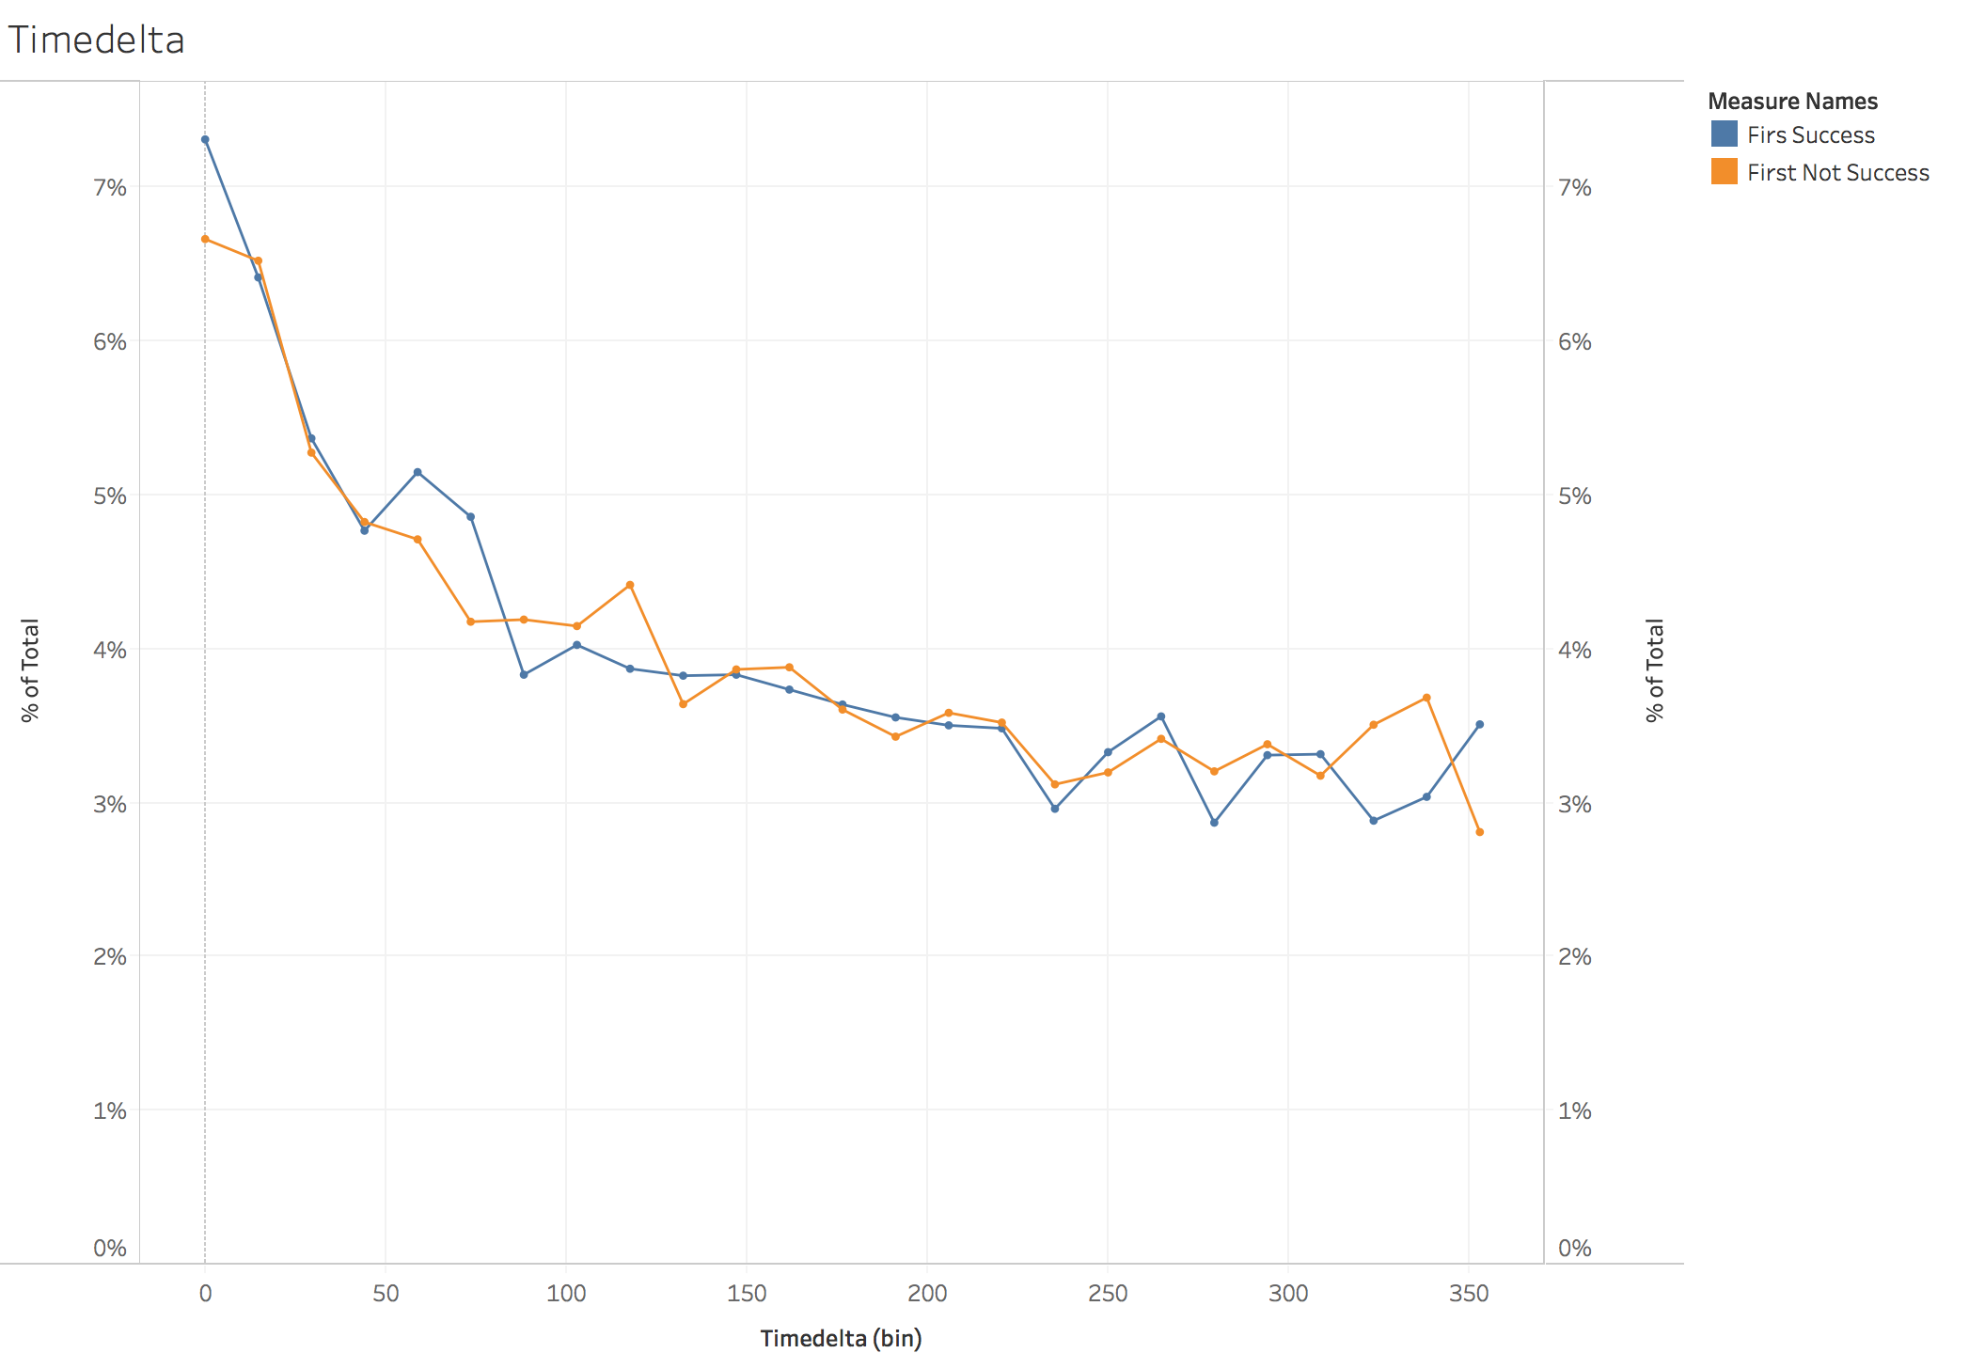
Time of returns
But, 12.2% vs 10.5% returns depending on success! (16% difference)

Slide 34
Geographic and thematic preferences
Do users support projects from the same category or same category more often?
Many possible reasons for such behavior?
Offer a crude measure of such preferences
Suppose a share of users P only supports a single category or from a single location; others at random
Estimate P:
Combined 0.26 (geo) +0.74*0.29 (cat) = 0.47

Slide 35
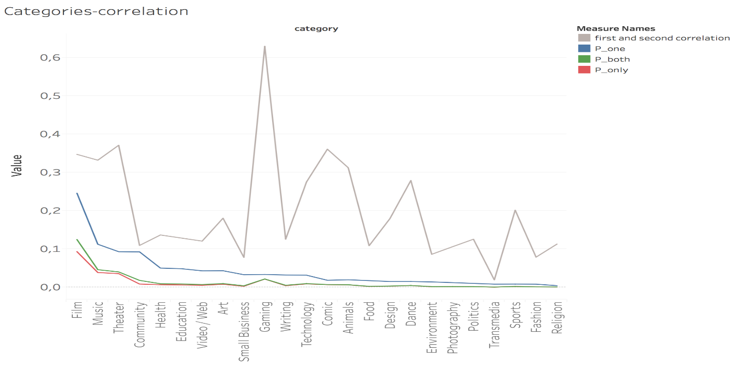
Geographic and thematic preferences

Slide 36
Geographic and thematic preferences

Slide 38
Competitive pressure
Does support of the project depends on the other simultaneously active projects?
Category factors:
-- Number of projects in the same category, launched 7, 14, and 28 days before this project;
-- The total goal of the projects in the same category, launched before (as in the previous point);
-- Ratios of factors in to the goal of the projects;
-- Geographic factors for a project (similar to category factors).
Project factors: goal, duration, dates of start and end, category.

Slide 39
Competitive Pressure
Project’s goal | Factors, related to project’s goal | AUC | Impact of competitive factors
All | Yes | 0,76 | 0,03
All | No | 0,63 | 0,33
≤ $10 000 | Yes | 0,72 | 0,04
≤ $10 000 | No | 0,59 | 0,24
> $10 000 | Yes | 0,64 | 0,18
> $10 000 | No | 0,61 | 0,31

Slide 40
Open questions
How advertisement/ information interacts with success/ failure?
Herding?
Crowdfunding as screening of entrepreneurs

