Slide 1
Машинное обучение и статистическая физика
А.В. Леонидов (ФИАН, МФТИ)

Slide 2
Статистическая физика
Рассмотрим систему бинарных переменных (нейронов) с энергией
В отсутствие шума

Slide 3
Статистическая физика
Температурный шум
Статистическая сумма

Slide 4
Статистическая физика
Пусть имеется компактное описание пространства конфигураций в терминах Q (может быть числом, вектором, матрицей, и т.д.), т.е.
Статистическая сумма принимает вид:

Slide 5
Статистическая физика
Равновесию в присутствии шума отвечают конфигурации
Равновесным конфигурациям отвечает минимум свободной энергии

Slide 6
Статистическая физика
Фазовые переходы: перестройка структуры Q при критической температуре
Статистическая физика и решение оптимизационных задач:
- Рассмотрим оптимизационную задачу, в которой нужно минимизировать целевую функцию L
- Накладываем больцмановский шум
- Устремляем Т к нулю (stimulated annealing)

Slide 7
Нейронные сети

Slide 8
Персептрон
Персептрон осуществляет бинарное отображение входного сигнала
Обучающая выборка

Slide 9
Персептрон
Определим
Определим энергию соотношением

Slide 10
Персептрон
Рассмотрим нормировку
Обучение персептрона

Slide 11
Interdisciplinary connections of DL
The recent striking success of deep neural networks in machine learning raises profound questions about the theoretical principles underlying their success. For example, what can such deep networks compute? How can we train them? How does information propagate through them? Why can they generalize? And how can we teach them to imagine?
Methods of physical analysis rooted in statistical mechanics have begun to shed conceptual insights into these questions. These insights yield connections between deep learning and diverse physical and mathematical topics, including random landscapes, spin glasses, jamming, dynamical phase transitions, chaos, Riemannian geometry, random matrix theory, free probability, and nonequilibrium statistical mechanics..
Y. Barhi et al, Statistical Mechanics of Deep Learning, Annu. Rev. Condens. Matter Phys. 2020. 11:501–28

Slide 12

Machine learning and statistical physics
Treat a loss function as an energy landscape in the weight’s space
Optimal weights correspond to the minima of
Learning is a process of finding a way to the true minimum from some starting configuration
In typical complex energy landscapes in physics this process often terminates in a false minimum
Apparently this does not happen for deep networks. Why?

Slide 13
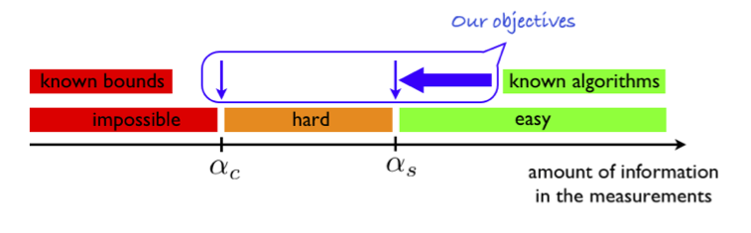
Phase transitions in inference problems
L. Zdeborova, F. Krzakala, Advances in Physics 65 (2016) , 453

Slide 14


Inference and statistical physics
Basic connection of inference to statistical physics is through Bayesian approach
Z(y) is not just normalization – as a partition function it carries information on the phases of inference process
Computation of Z(y) can be done using methods like MP, variational MP, etc.
MMSE (MMO): , MAP:

Slide 15
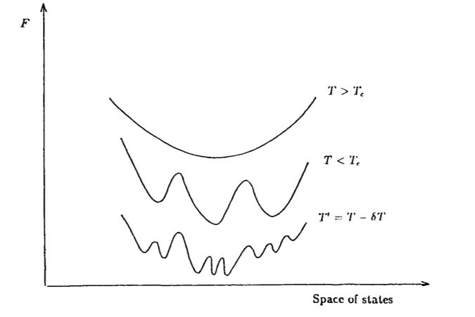
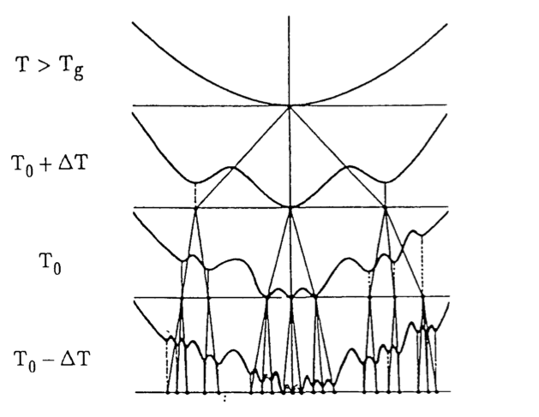
Hierarchical structure of SG energy landscape

Slide 16
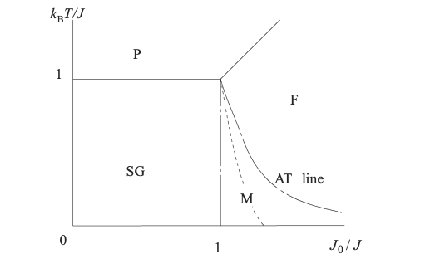
Phase diagram of SG

Slide 17
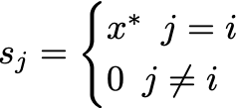
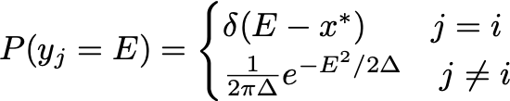
Phase transition in signal denoising
Signal
Noise

Slide 18
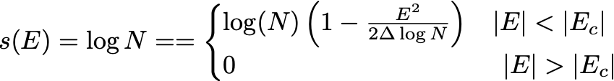
Phase transition in signal denoising
Average number of events within an interval
The corresponding entropy

Slide 19



Random energy model
Consider 2^{N} configurations with iid energies
Gaussian energy distribution
Partition function
Level density

Slide 20


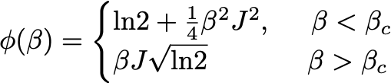
Phase transition in REM
Partition function
Critical temperature
Glassy phase transition

Slide 21
Phase Diagram of Random Energy Model

Slide 22
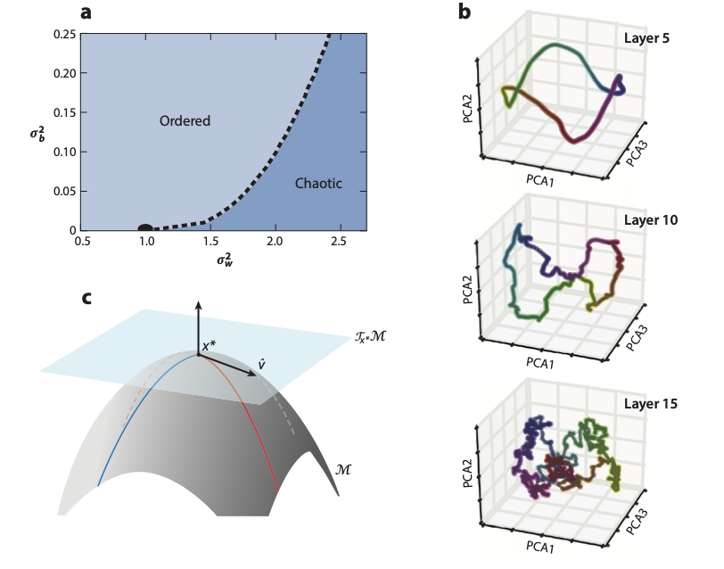

Expressivity of DNN: phase transition
Random W, b
Phase transition in
plane

Slide 23
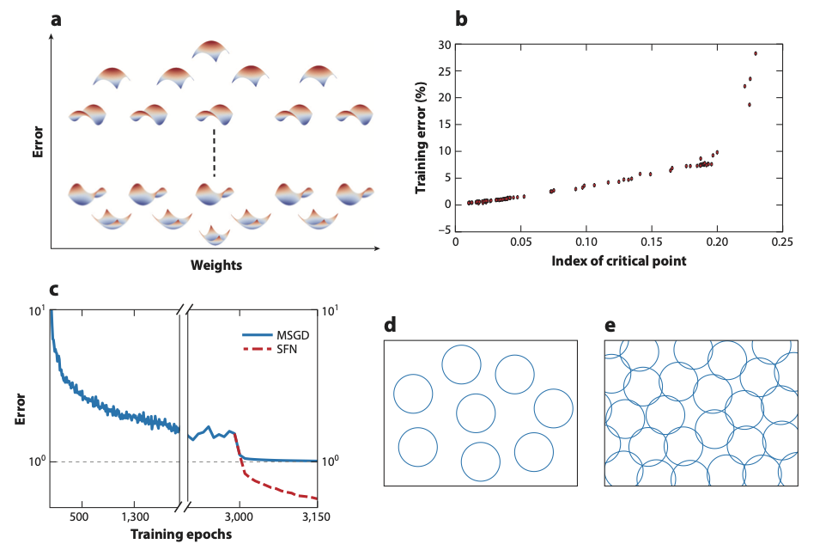
Random landscape
Эволюция ландшафта
Зависимость ошибки от индекса критической точки

Slide 24



Jamming transition for spheres
Set of spheres of radius R at distances r_{ij} = |r_{i} – r_{j}|
Overlap
Two particles are in contact if
: number of pairs in contact
Potential energy:

Slide 25


Jamming transition in particle systems
Key structural property of jamming transition is in power-law dependencies
The marginal stability regime implies that dynamics proceeds through avalanches and is associated with self-similar picture reminiscent of replica symmetry breaking

Slide 26
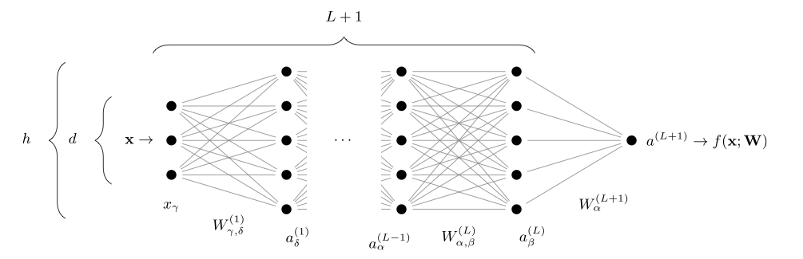
Deep learning vs jamming transition

Slide 27
Deep learning vs jamming transition

Slide 28
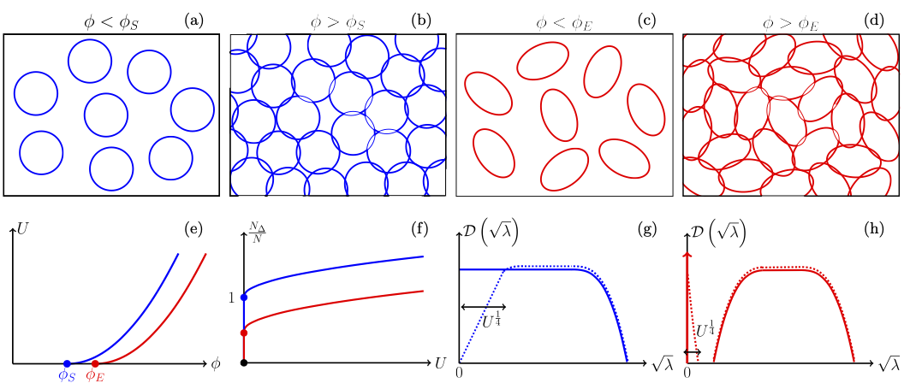
Jamming transition for spheres/ellipsoids

Slide 29
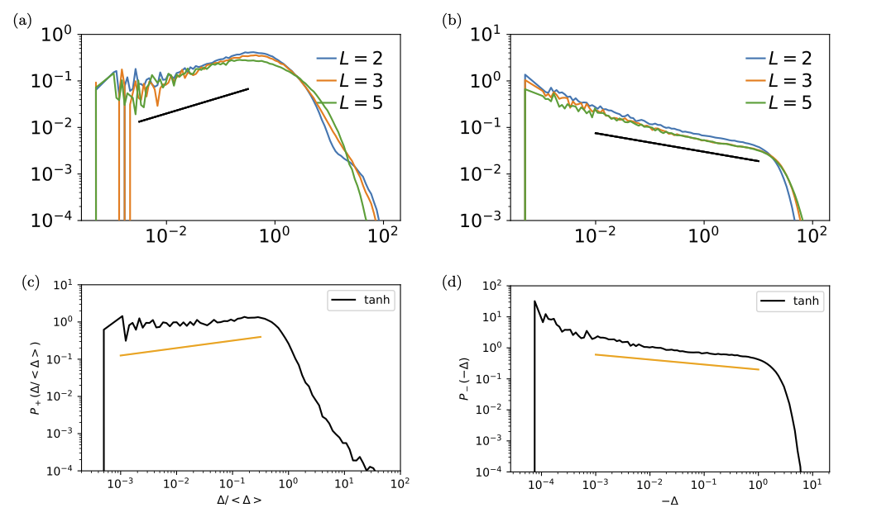
Distributions of gaps

Slide 30
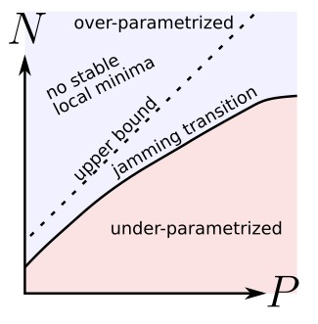
Jamming phase transition in DNN
Easy phase: over-parametrized networks, dynamics is governed by a massive amount of flat directions, learning achieved
Hard phase: under-parametrized networks, landscape is rough, dynamics glassy, learning difficult/impossible
Near transition the loss landscape has an
hierarchical structure and learning dynamics
is characterized by avalanche formation
with abrupt changes in the set of patterns that
are learned

Slide 31
Resolution – relevance tradeoff
Neural networks associate similar inputs in the visible layer to the same state of hidden variables in deep layers.
The fraction of inputs that are associated to the same state is a natural measure of similarity and is simply related to the cost in bits required to represent these inputs.
The degeneracy of states with the same information cost provides instead a natural measure of noise and is simply related the entropy of the frequency of states, that we call relevance.
Representations with minimal noise, at a given level of resolution, are those that maximize the relevance. A signature of such efficient representations is that frequency distributions follow power laws.
Deep neural networks extract a hierarchy of efficient representations from data, because they (i) achieve low levels of noise (i.e. high relevance) and (ii) exhibit power law distributions.
J. Song et al. J. Stat. Mech. (2018) 123406

Slide 32

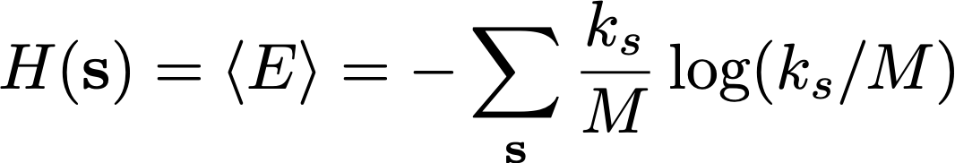
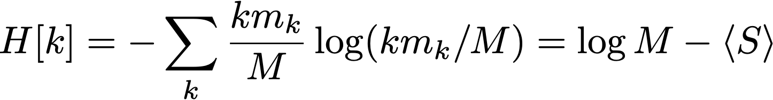
Resolution – relevance tradeoff
The only quantitative measure of similarity of inputs: number of inputs corresponding to the same state s for measure a given layer: k_{s}
Information cost
Average information cost
Number of states with given E(s) : m_{k}
Relevance

Slide 33
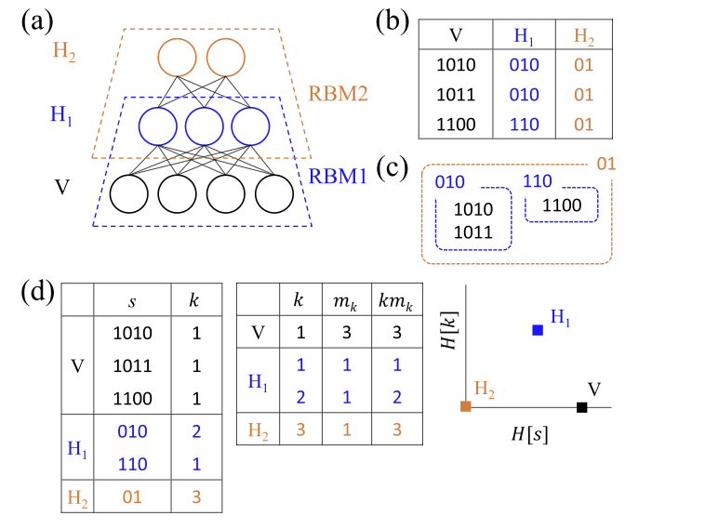
Information processing in deep learning

Slide 34
Statistical criticality in deep learning
Maximal relevance for given resolution
Power-like distribution in m_{k}

